Slide 1
Bake-up Bakery

Slide 2
CONTENTS
01
02
03
Home Page
Menu
Special offers
Bakery images
Product descriptions
Pricing
Best-selling
promotions, discounts,
or seasonal specials
Welcome display
company value
04
05
Contact us
Location
Contact Information
business hours
Social links
GPS location
Map displays

Slide 3
Home Page Layout
Bakery shop name
Replace with your own text
Navigation (menu bar)
Video displays
Company History
Bakery image

Slide 4


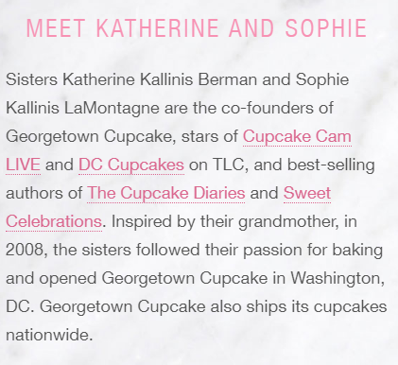


Slide 5
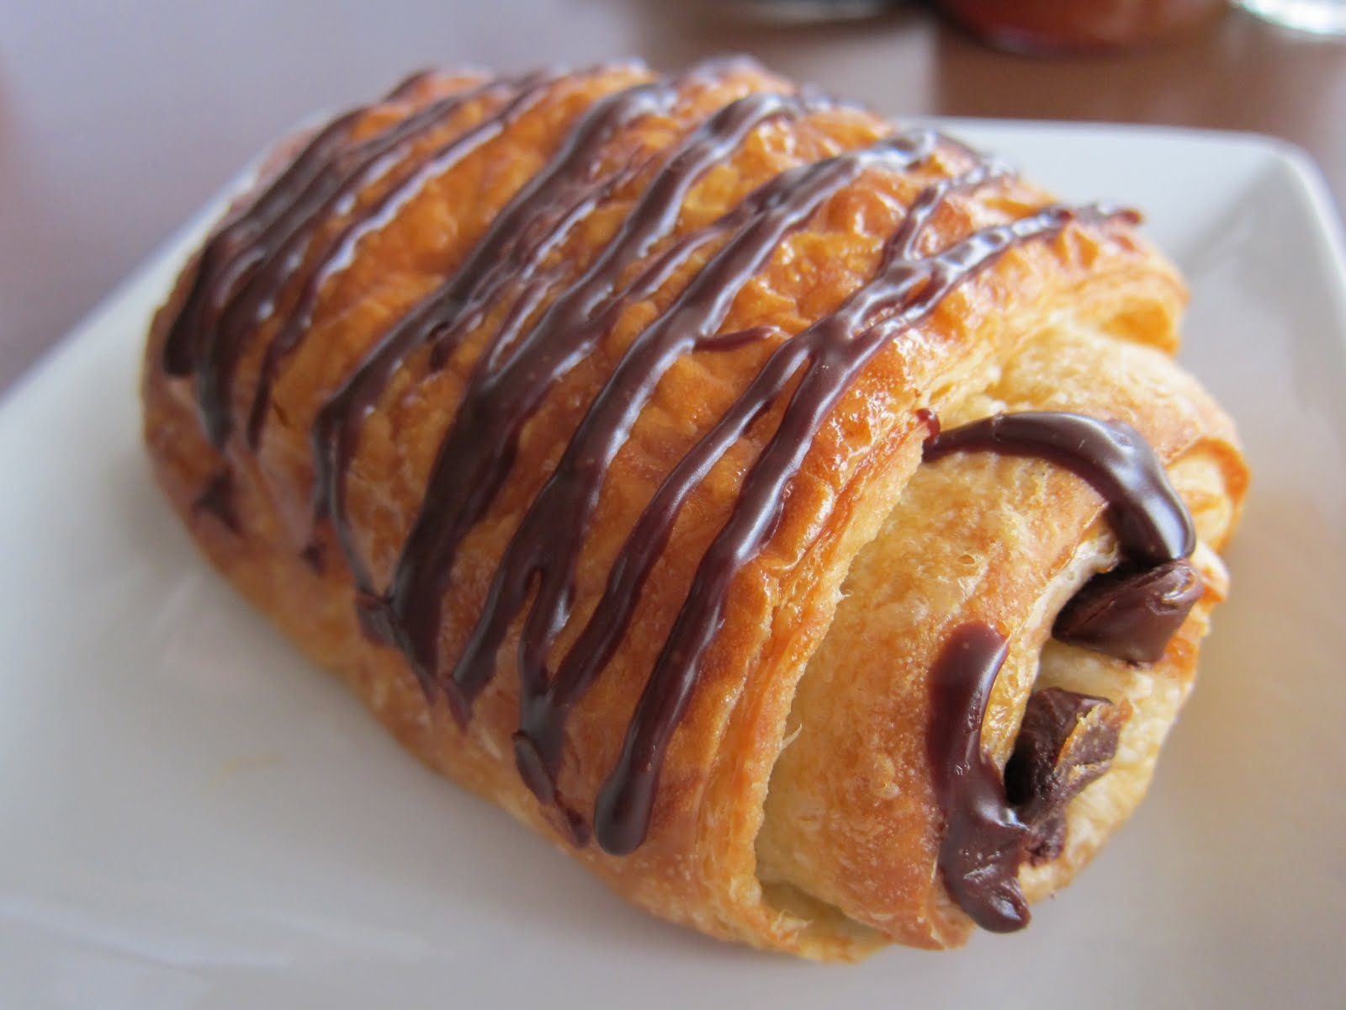
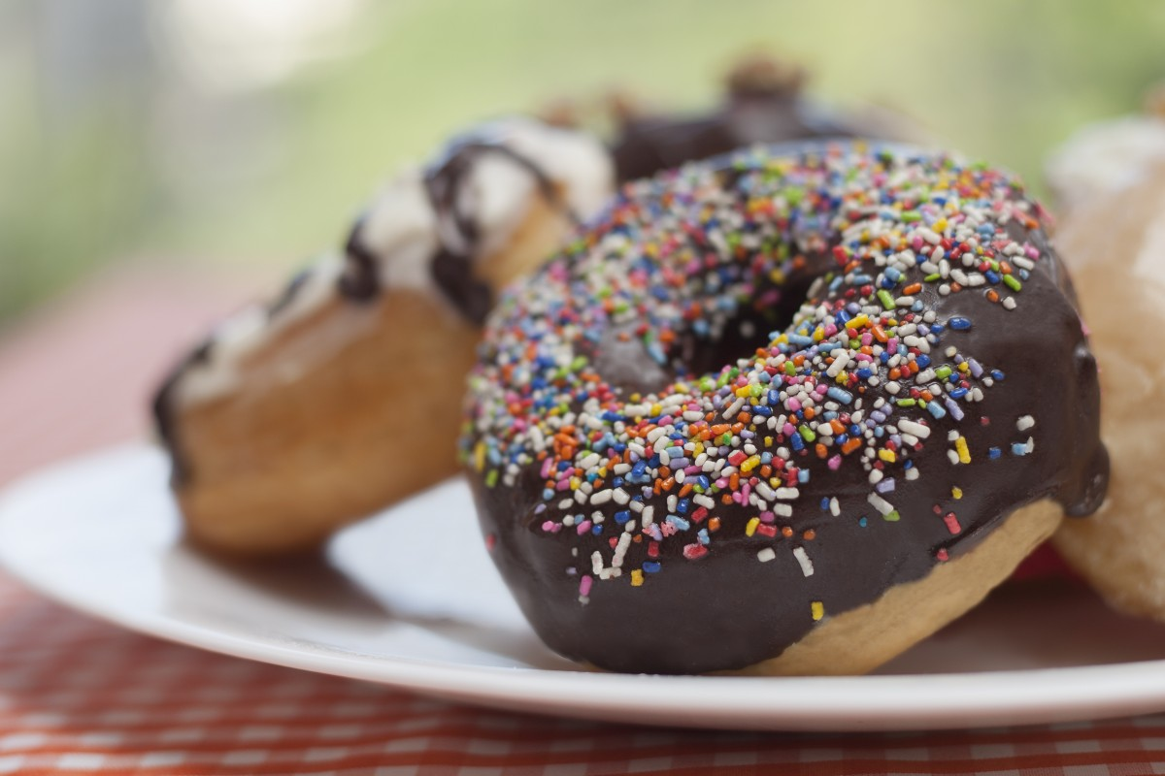
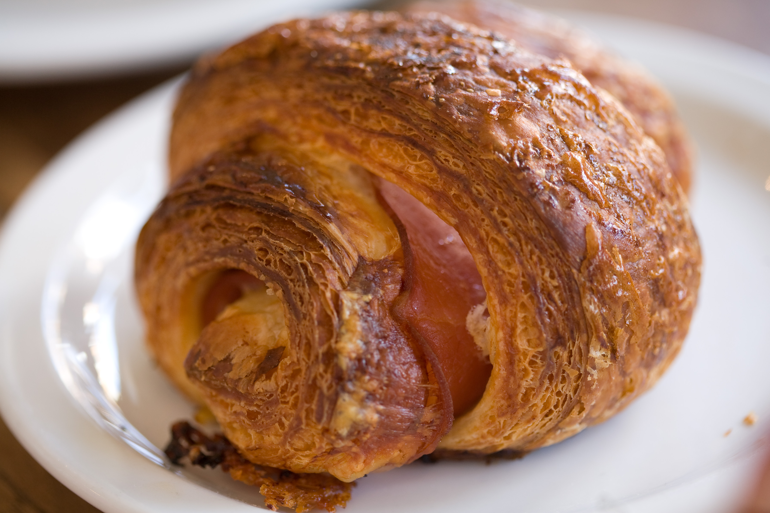
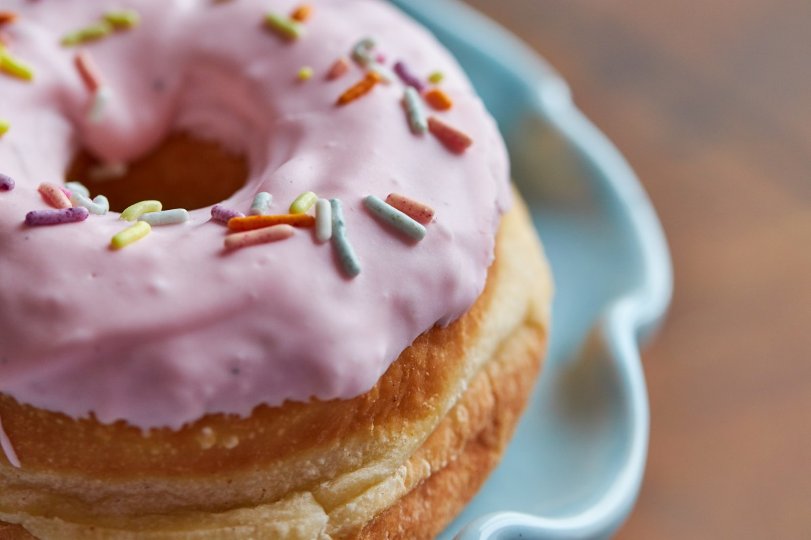
Menu Layout
BAKERY SHOP NAME
MENU
CROSSANTS
DOUGHNUTS
DRINKS
SEASONALS

Slide 6
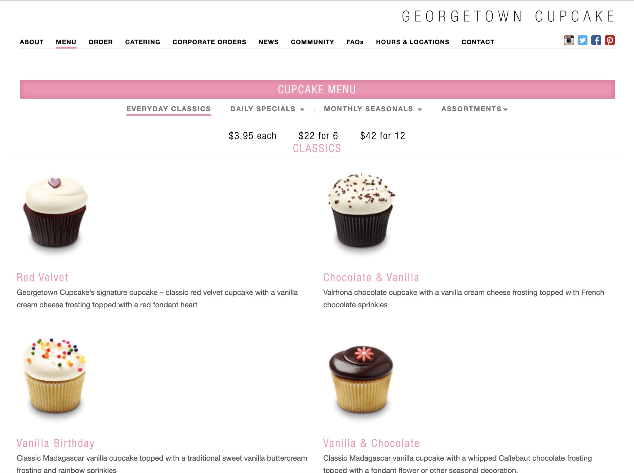

Slide 7
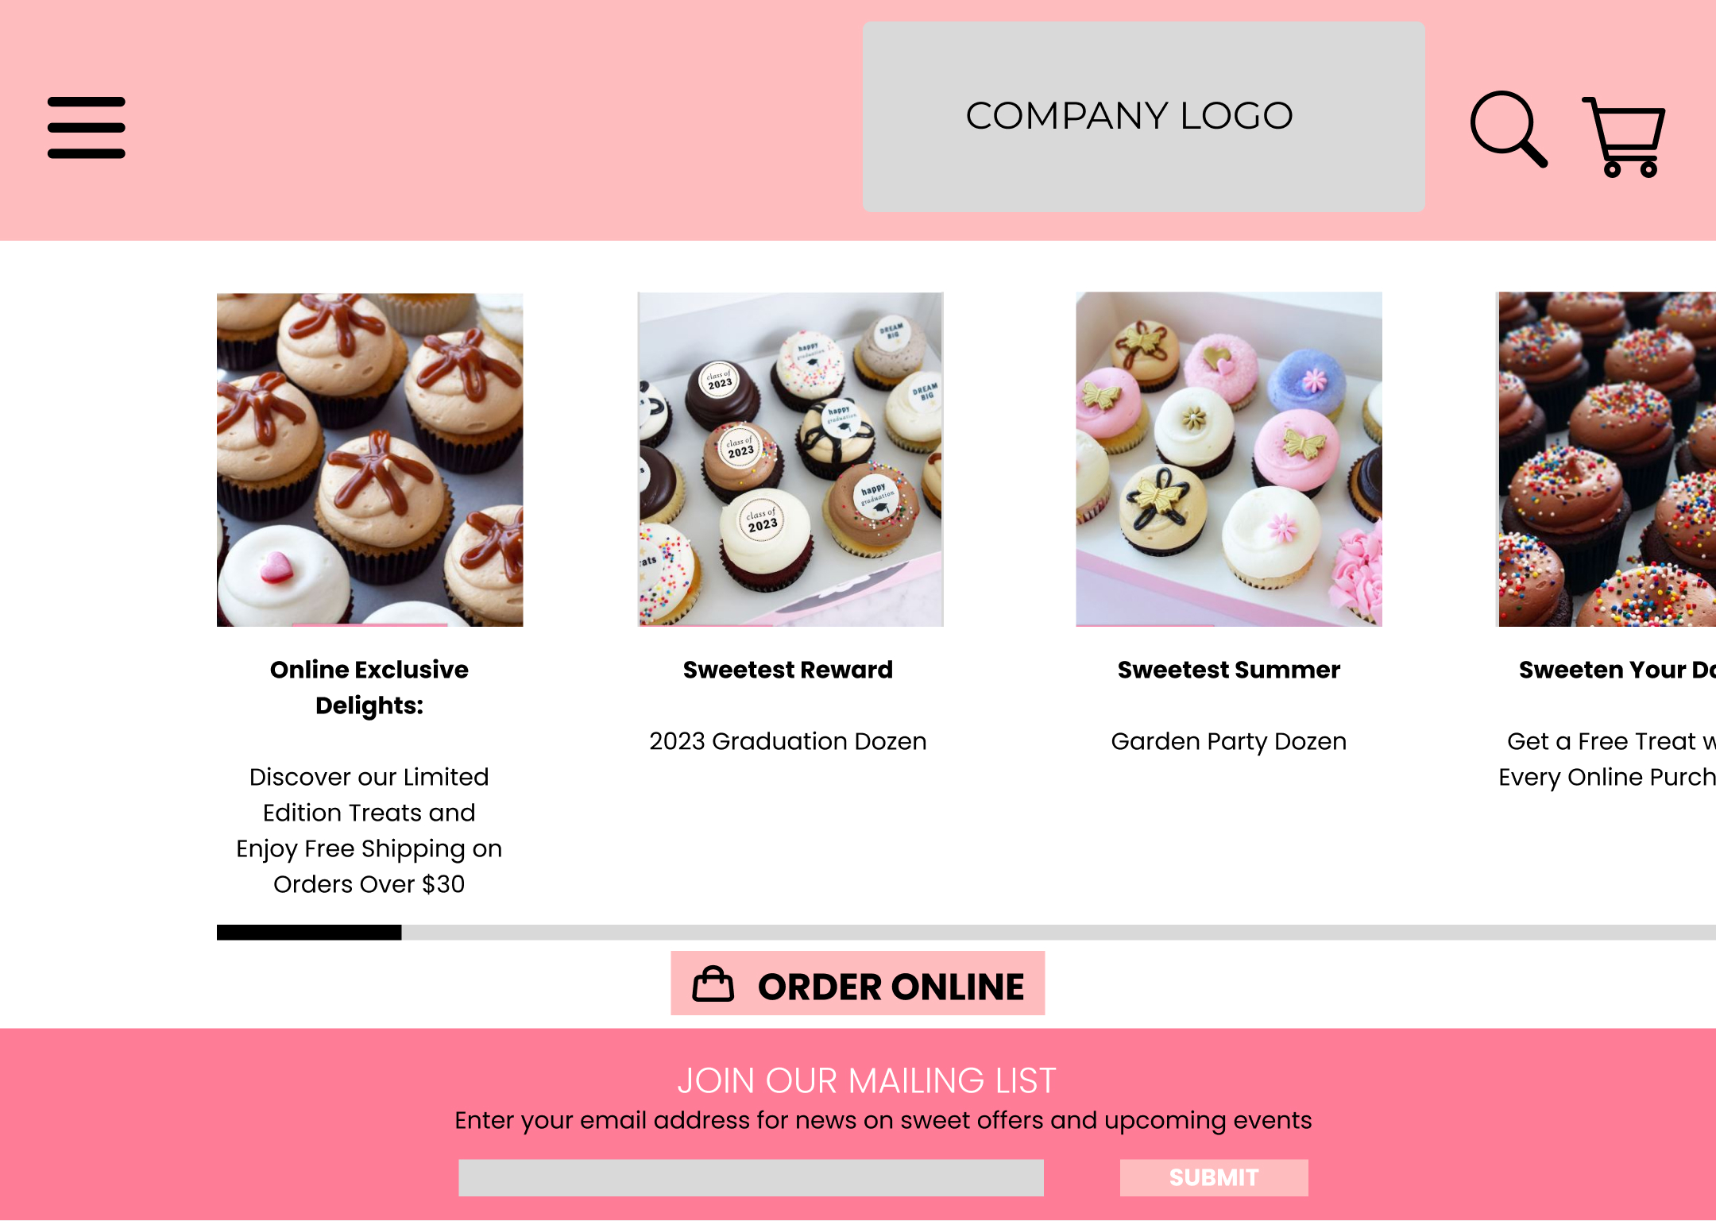
Special Offers Layout
Replace with your own text

Slide 8
Contact us & Location Layout
Header (the bakery image Will be apear here)
Contact us
SocialNetworks
email@bakeryname.com
Phone Number
Only the email address and the phone number will be shown, when the page will be created, we have to reference gmail or whats app app
Only the social media icons will be shown, when the page will be created, we have to reference to the apps link

Slide 9
Contact us & Location Layout
Header (the bakery image Will be apear here)
Location Address 1
Location Address 2
Only the Address will be shown, when the page will be created, we have to reference the icon or maps image with a google maps link

Slide 10

Inspirational websites
Link: https://www.georgetowncupcake.com/Default.aspx.com
Proposal of colors for the desing

Slide 11
THANK YOU

